Slide 1
Group 8
Level 4/5 Group 8: Petrut Vasile, Sorin Cristea, Louis Vagner

Slide 2
Brief
Choose a game genre
Change of a basic mechanic
Single player Game
Intuitive gameplay
Notes:
ASSESSMENT CRITERIA
Ability to deliver a complete game against an initial design specification.
Quality of game play experience.
Quality of iterative development of the game.
Ability to satisfy an identified market through appropriate game play design.
Ability to contribute to effective team working.
Ability to communicate game and individual progress in a consistent and effective manner to stakeholders.
Ability to produce assets in time and to standard.
Ability to use documentation and software related to project management in a consistent and effective manner.
Ability to reflect on work and to identify best practice on a range of issues.

Slide 3
Emotions
Easy fun
Sense of accomplishment
Wonder

Slide 4
Mechanics
No Perma-death
Solution : body switch with the killer
Dungeon generator
AI for enemies
Point and click movement
Notes:
A RogueLike game is characterized by a dungeon crawl through procedurally generated levels, turned-based gameplay, tile-based graphics and permanent death of the player character.
We took off the permanent death mechanic and decided instead that the player can never die. If your player loses against an enemy, you then take control of that enemy.

Slide 5
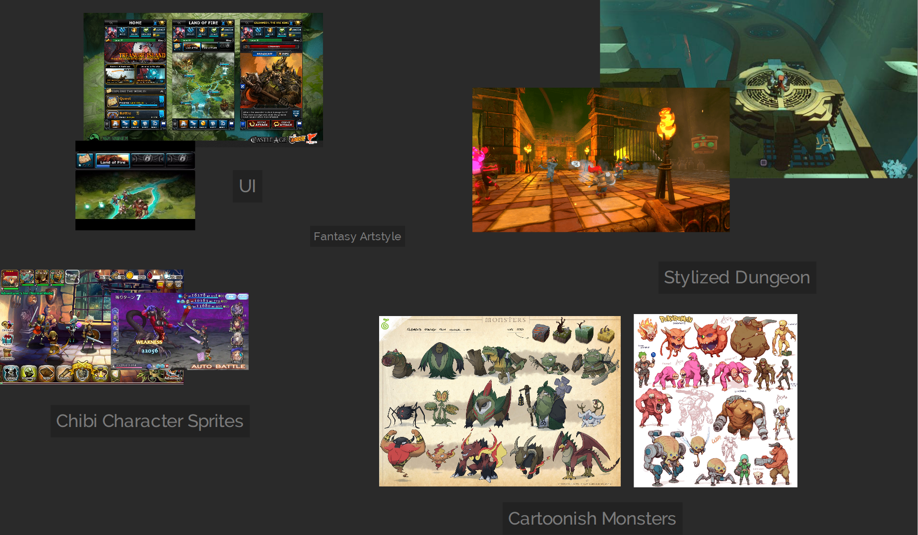
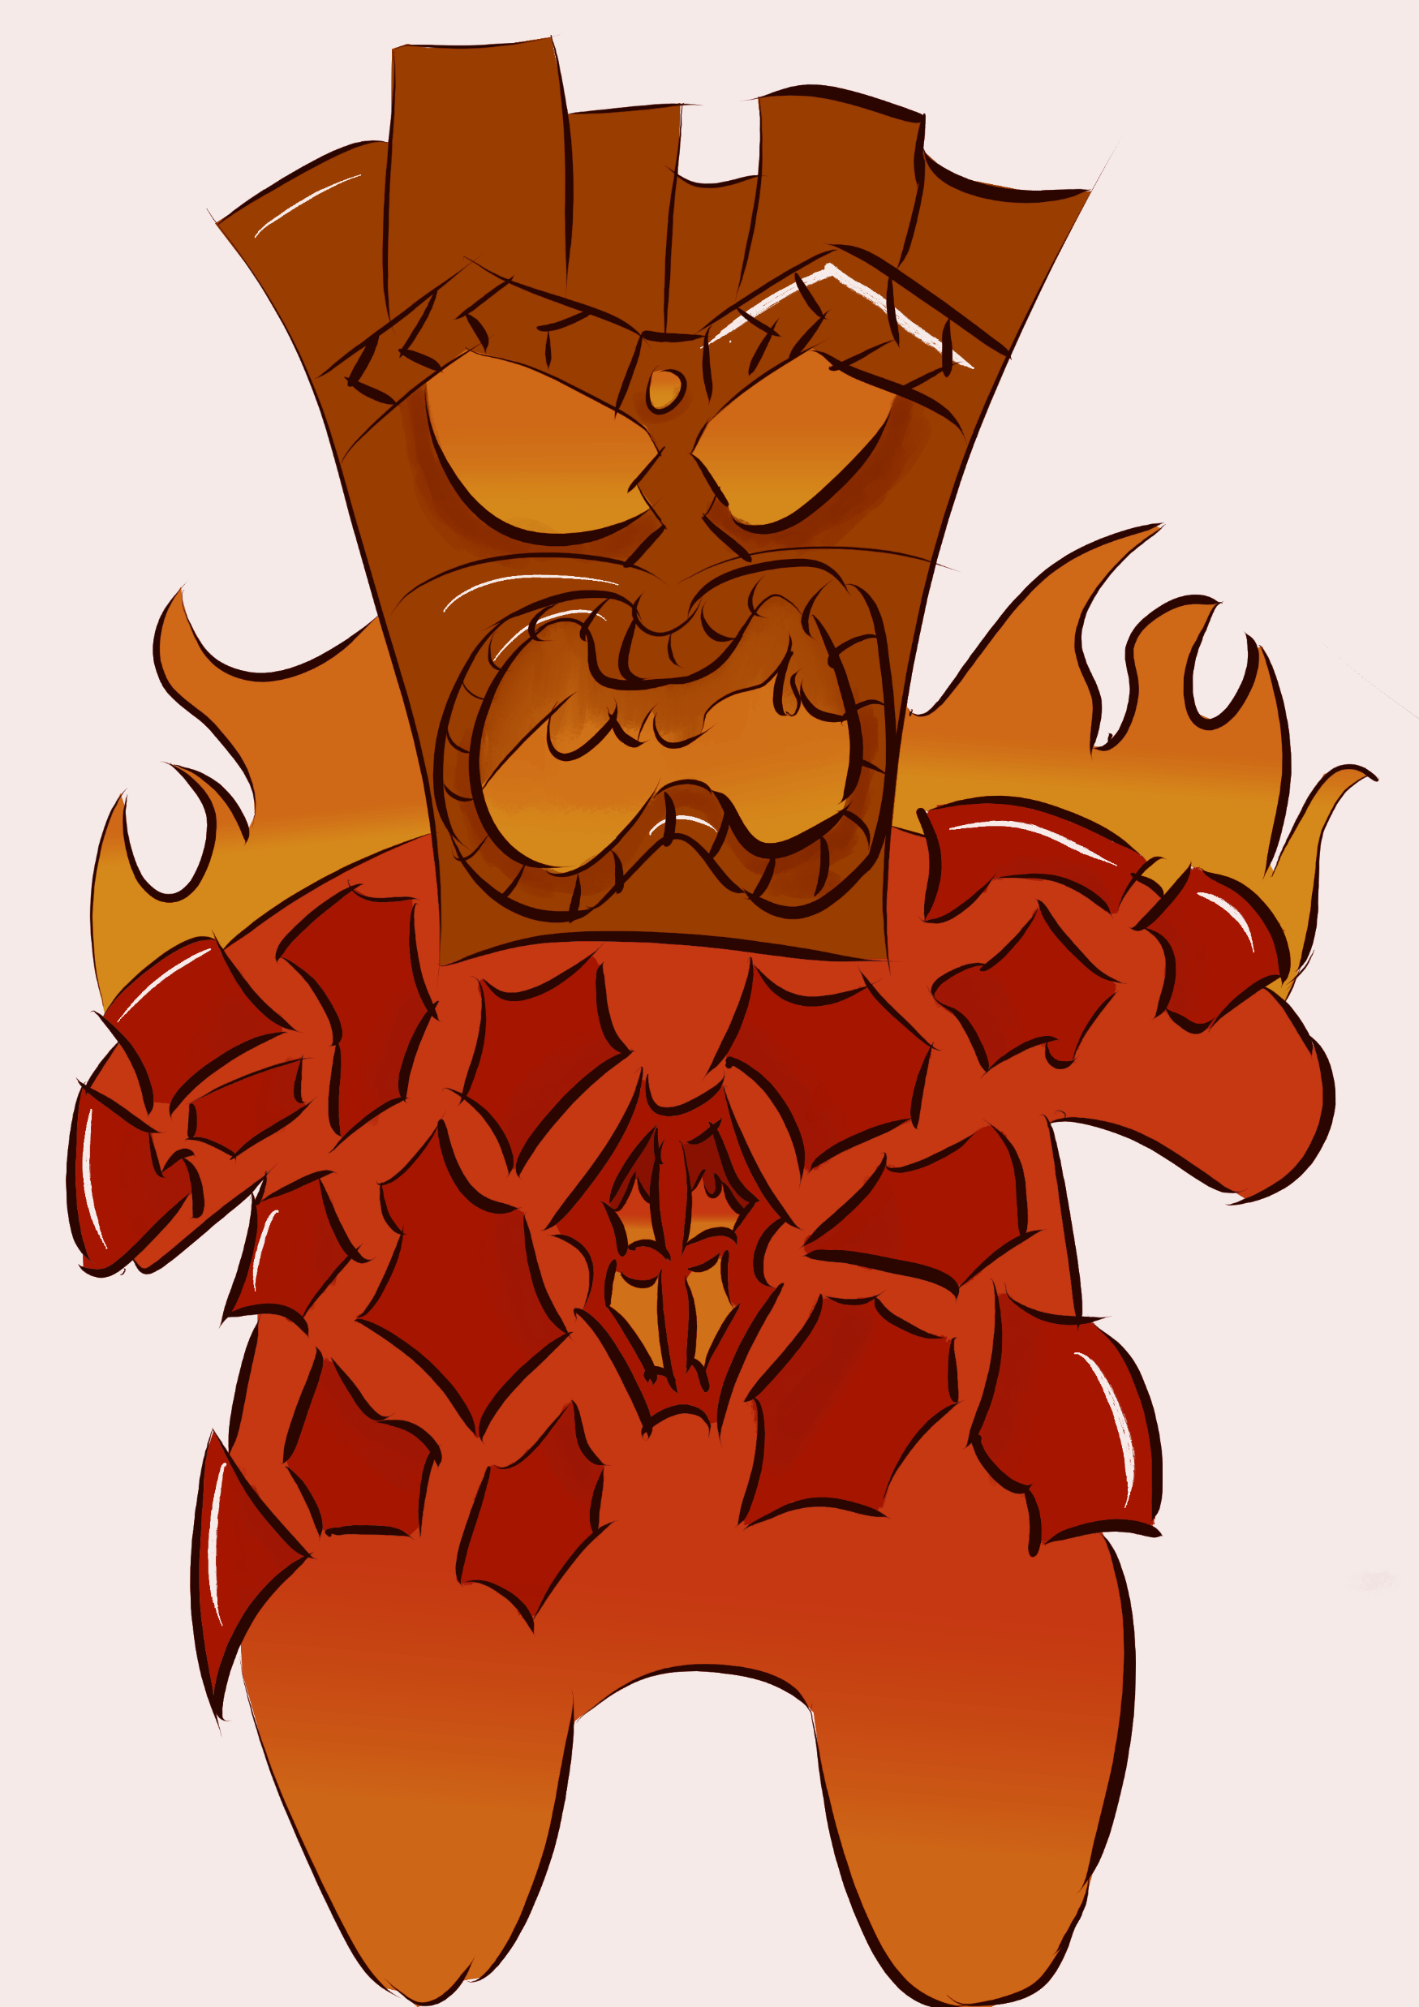
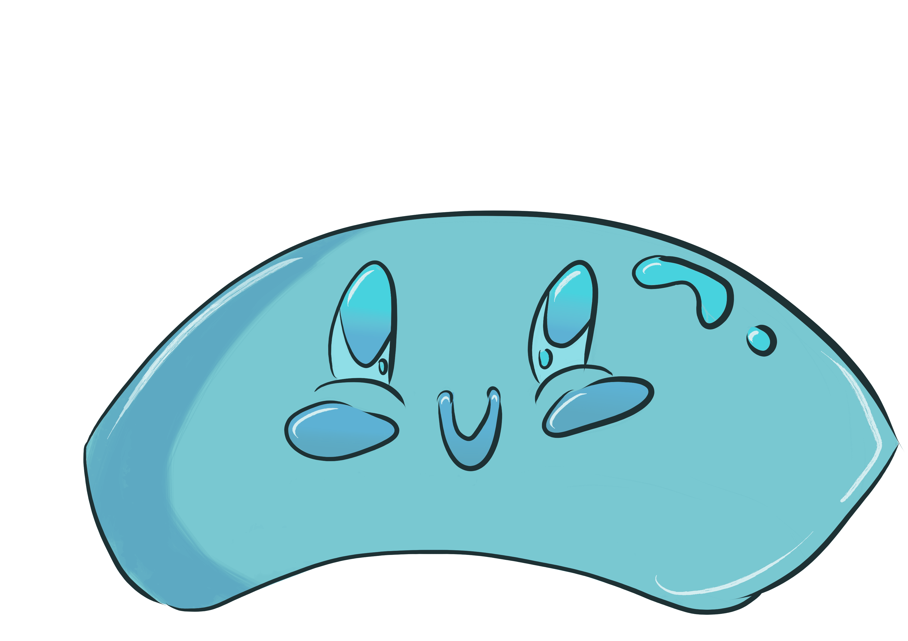
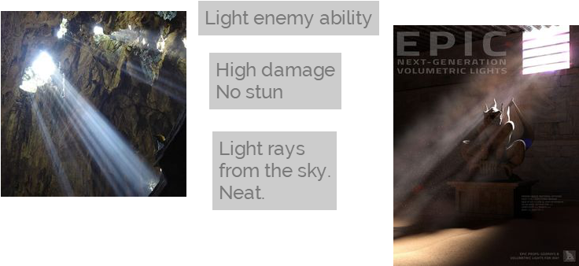
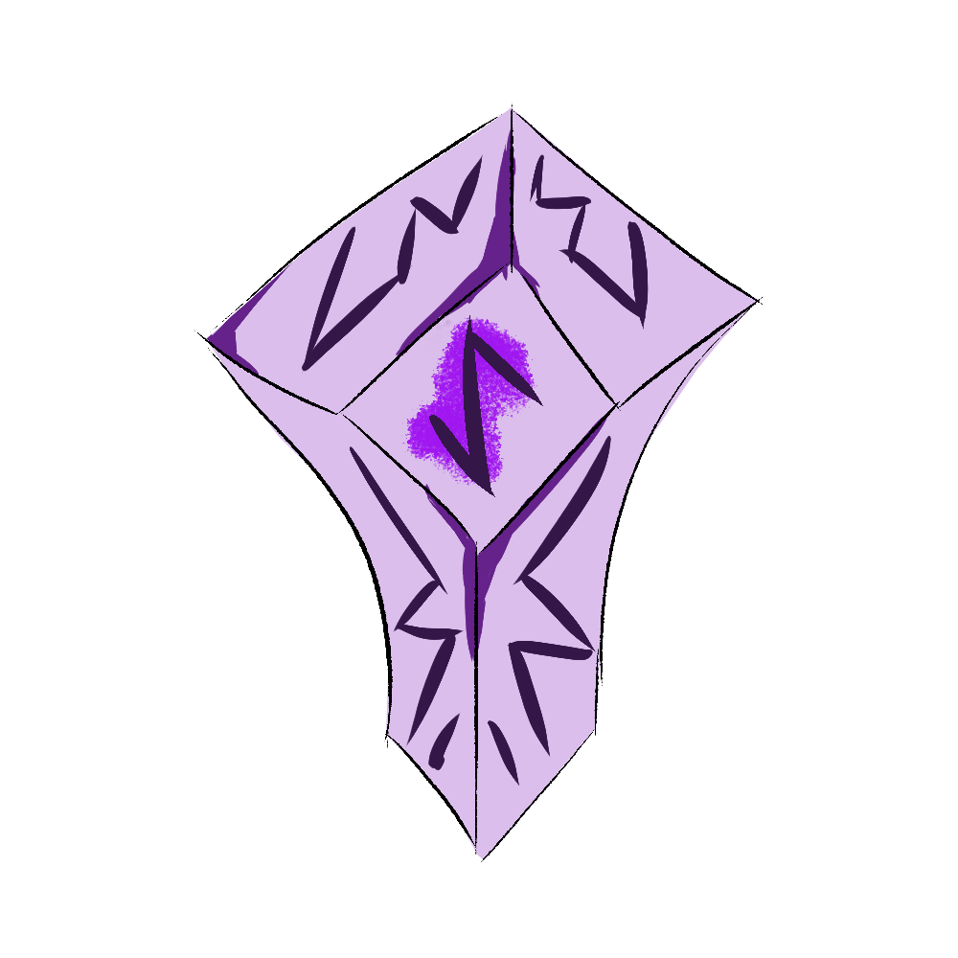


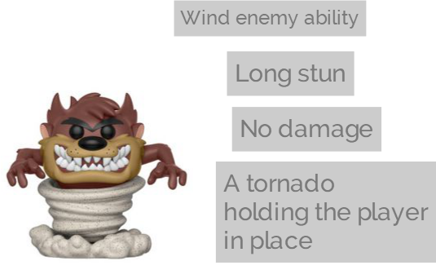
Art

Slide 6
Walkthrough

Slide 7
The following weeks
Testing
Balancing
Creating a tutorial level
Polishing

